Slide 1



Introduction to Hidden Markov Model (Prof. Bong-Kee Sin’s Lecture Notes Revisited)
Ahmad Wisnu Mulyadi
2016.03.02

Slide 2
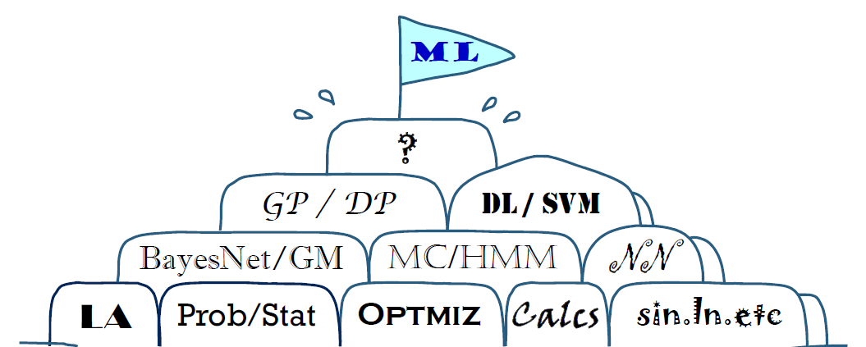
Machine Learning
Notes:
LA : Linear Algebra
Calcs : Calculus
Ln : Natural Logarithm
GM : Graphic Models
MC : Markov Chain
GP : Gaussian process
DP : Dirichlet process
DL : Deep Learning
SVM : Support Vector Machine
ML : Machine Learning

Slide 3

Markov Chain
Sequential data comes one by one :
1 $P\left(x_{1}\right) : x_{1}→1$
1 1 $P\left(x_{2}|x_{1}\right) : x_{2}→1$
1 1 0 $P\left(x_{3}|x_{2},x_{1}\right) : x_{3}→0$
1 1 0 1 $P\left(x_{4}|x_{3},x_{2},x_{1}\right) : x_{4}→1$

Slide 4
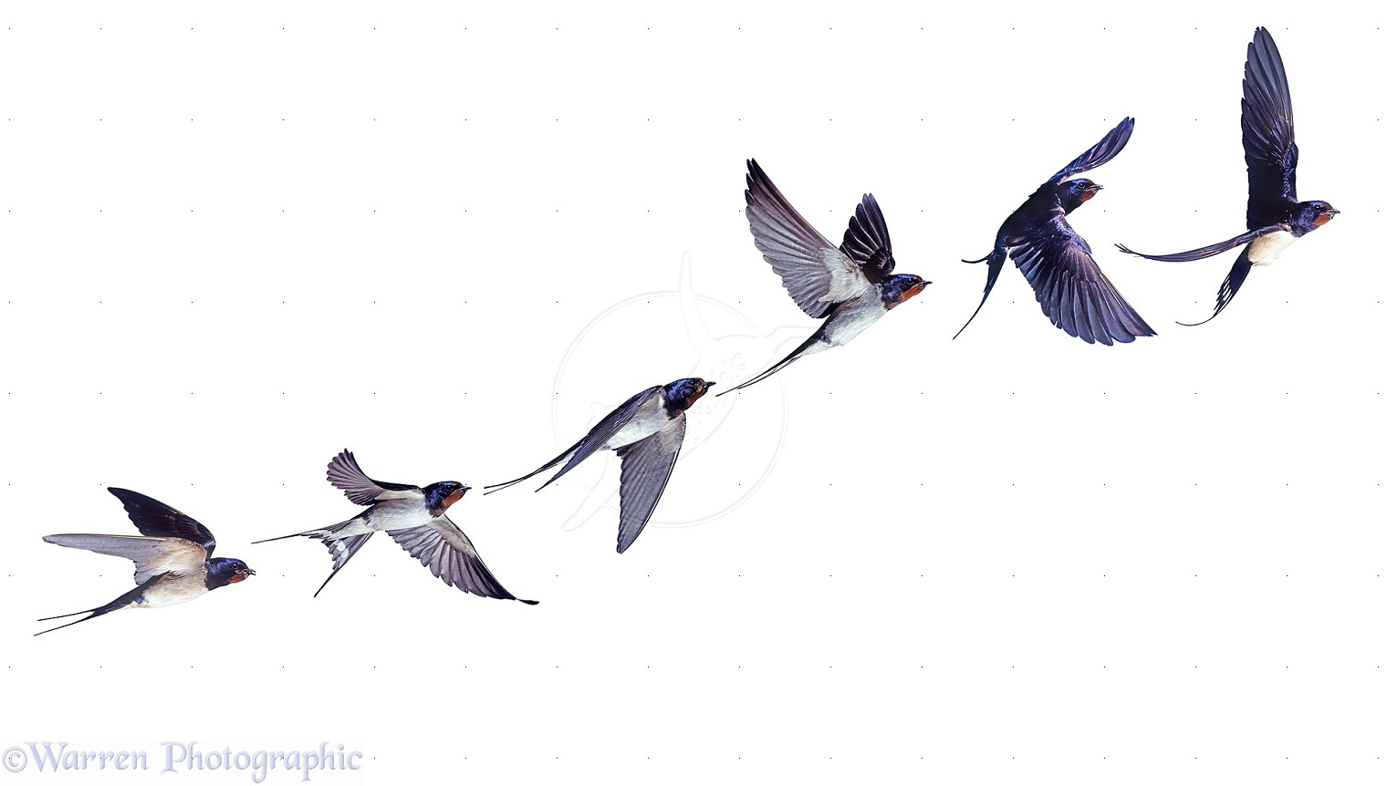
Markov Chain
$x_{1}$ $x_{2}$ $x_{3}$ $x_{4}$ $x_{5}$ $x_{6}$
https://shiyalinabo.files.wordpress.com/

Slide 5




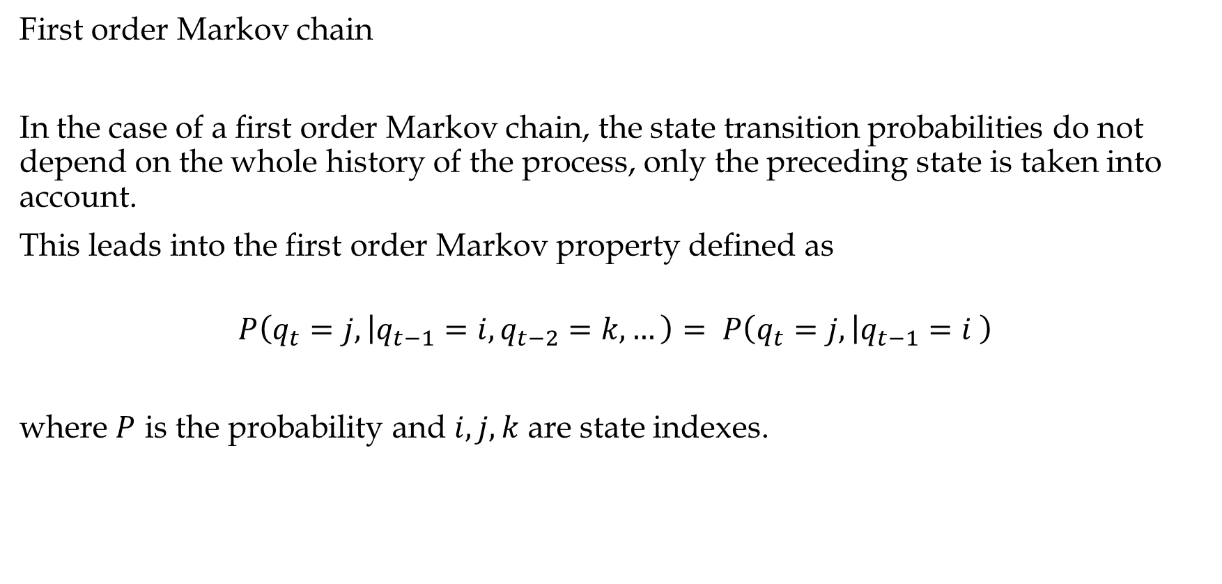




Markov Chain
First order Markov chain
In the case of a first order Markov chain, the state transition probabilities do not depend on the whole history of the process, only the preceding state is taken into account.
This leads into the first order Markov property defined as
$$P\left(q_{t}=j, | q_{t−1}=i,q_{t−2}=k,…\right)= P\left(q_{t}=j, | q_{t−1}=i \right)$$
where $P$ is the probability and $i, j, k$ are state indexes.
$t$-3
$$t\text{−}\text{2}$$
$$t\text{−}\text{1}$$
$$t$$
$$t\text{+}\text{1}$$

Slide 6
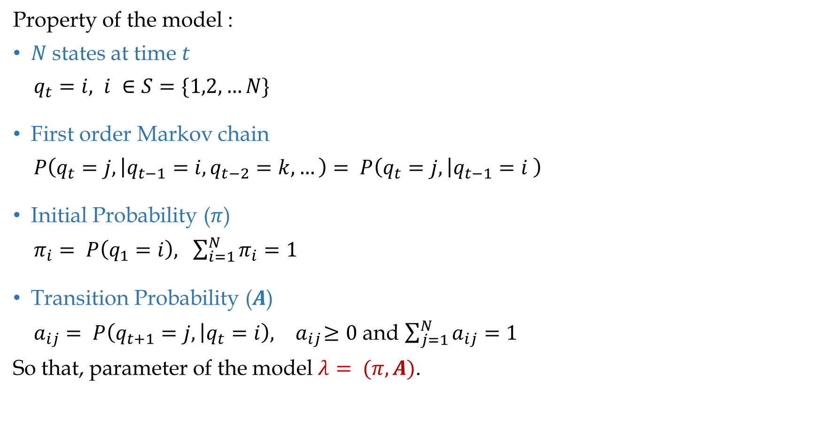
Markov Chain
Property of the model :
$N$states at time $t$
$q_{t}=i, i ∈S=\{1,2,…N\}$
First order Markov chain
$P\left(q_{t}=j, | q_{t−1}=i,q_{t−2}=k,…\right)= P\left(q_{t}=j, | q_{t−1}=i \right)$
Initial Probability ($π$)
$π_{i}= P\left(q_{1}=i\right),$ $\sum_{i=1}^{N}{π_{i}=1}$
Transition Probability ($A$)
$a_{ij}= P\left(q_{t+1}=j, | q_{t}=i\right),{ a}_{ij}≥0$ and $\sum_{j=1}^{N}{a_{ij}=1}$
So that, parameter of the model $λ= (π, A)$.

Slide 7


Markov Chain
Weather forecast
4 States
Cloudy
Sunny
Rainy
Windy
http://img12.deviantart.net/bbbf/i/2011/244/f/5/pointing_at_sky_by_moguinho-d48i1ph.jpg

Slide 8
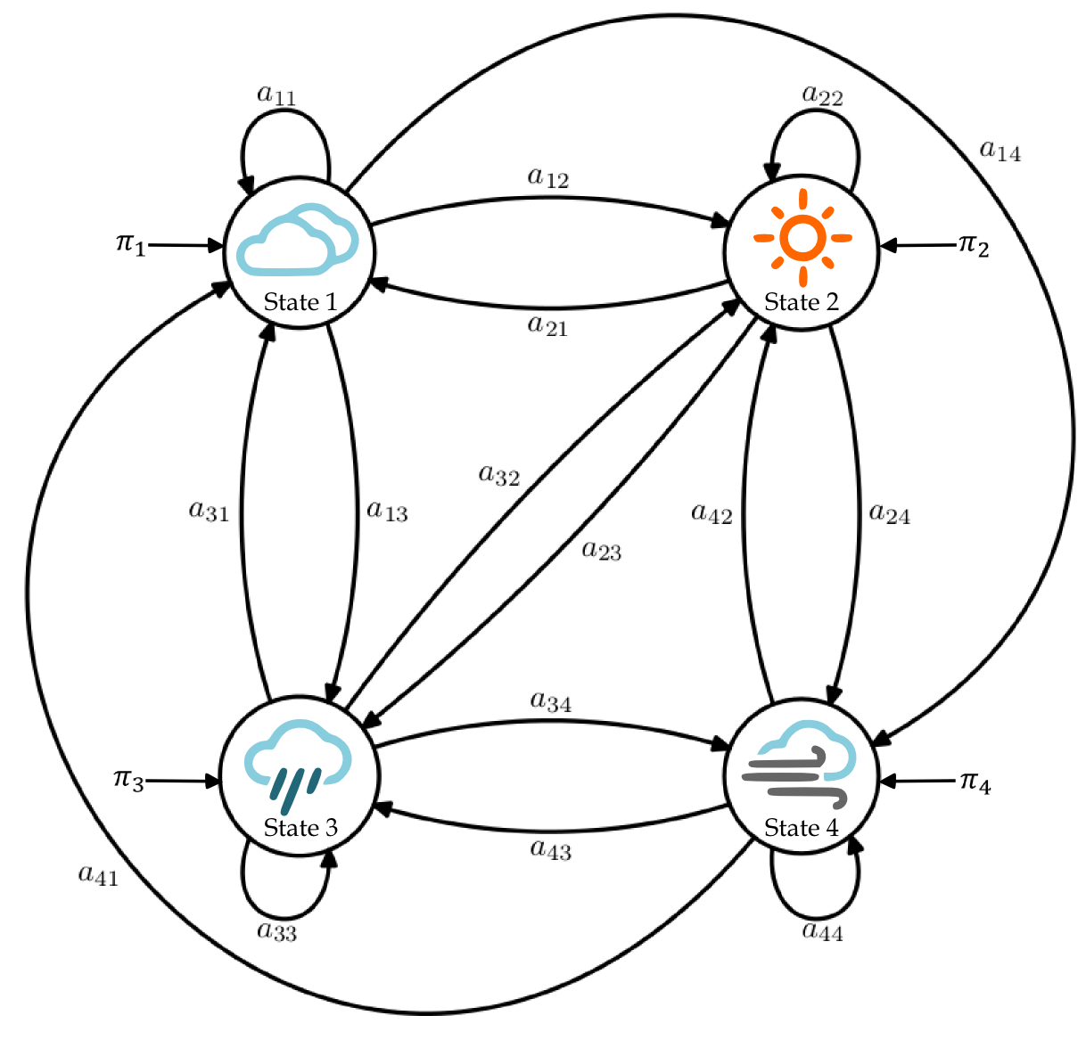






















Markov Chain
Initial State Probability $π$
$$π_{1}$$
$$π_{2}$$
$$π_{3}$$
$$π_{4}$$
State Transition Probability $A$
$$a_{11}$$
$$a_{12}$$
$$a_{13}$$
$$a_{14}$$
$$a_{21}$$
$$a_{22}$$
$$a_{23}$$
$$a_{24}$$
$$a_{31}$$
$$a_{32}$$
$$a_{33}$$
$$a_{34}$$
$$a_{41}$$
$$a_{42}$$
$$a_{43}$$
$$a_{44}$$

Slide 9

Markov Chain
Stochastic Automaton
$Q= q_{1}{ q}_{2}{ q}_{3}$ … $q_{T}$
$$P\left(O=Q\right|π,A)=P(q_{1})\prod_{t=1}^{T}{P(q_{t}|q_{t−1})}$$
$= π_{q_{1}}a_{q_{1}q_{2}}a_{q_{2}q_{3}}…a_{q_{T−1}q_{T}}$

Slide 10
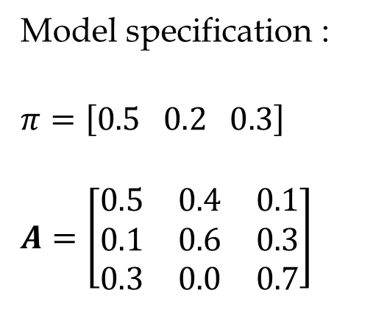
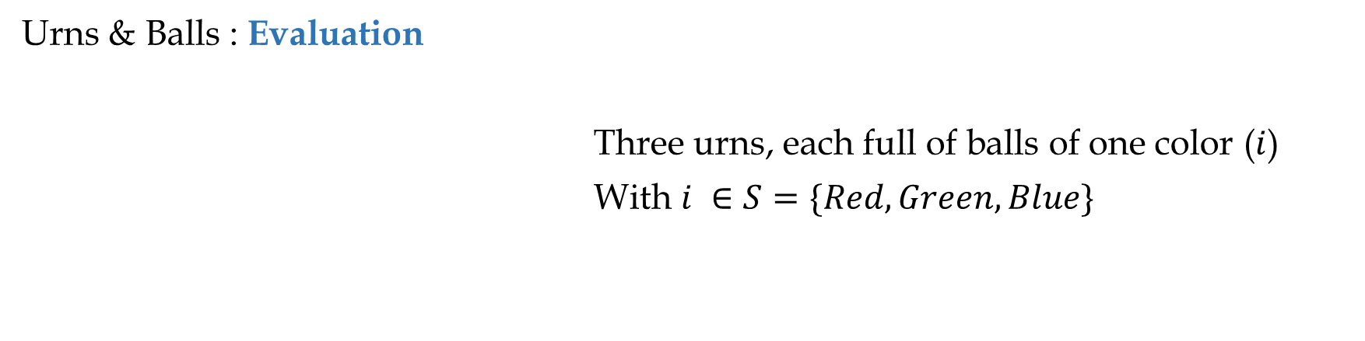
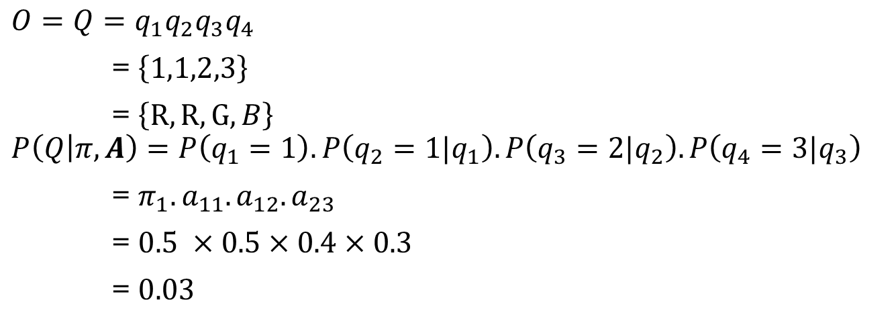
Discrete State Markov Chain
Urns & Balls : Evaluation
Three urns, each full of balls of one color ($i$)
With $i ∈S=\{Red, Green, Blue\}$
Red
Green
Blue
Model specification :
$$π=\left[0.5 0.2 0.3\right]$$
$$A=\left[\begin{matrix}0.5 & 0.4 & 0.1 \\ 0.1 & 0.6 & 0.3 \\ 0.3 & 0.0 & 0.7\end{matrix}\right]$$
$$O=Q=q_{1}q_{2}q_{3}q_{4}$$
= $\left\{1,1,2,3\right\}$
= $\left\{R,R,G,B\right\}$
$$P\left(Q | π,A\right)=P\left(q_{1}=1\right).P\left(q_{2}=1|q_{1}\right).P\left(q_{3}=2|q_{2}\right).P\left(q_{4}=3|q_{3}\right)$$
= $π_{1}.a_{11}.a_{12}.a_{23}$
= $0.5 ×0.5×0.4×0.3$
= $0.03$

Slide 11
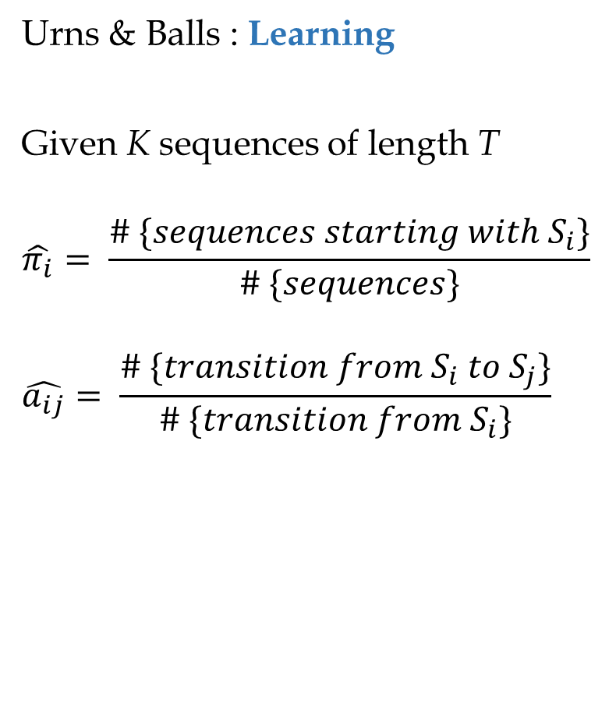
Discrete State Markov Chain
Urns & Balls : Learning
Given K sequences of length T
$$\hat{π_{i}}= \frac{\# \{sequences starting with S_{i}\}}{\# \{sequences\}}$$
$$\hat{a_{ij}}= \frac{\# \{transition from S_{i} to S_{j}\}}{\# \{transition from S_{i}\}}$$
Learning from single sequence :
(1,1,1,0,0,1,1,0,0,0,1)
Learning from multiple sequences :
(1, 1, 3, 3)
(2, 1, 3)
(1, 2, 3, 2, 2)

Slide 12

http://denvercounseling.com/wp-content/uploads/2014/05/behind-closed-doors_secret.jpg

Slide 13
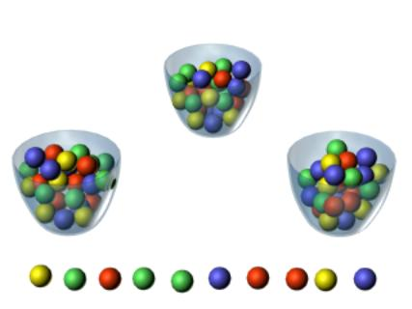
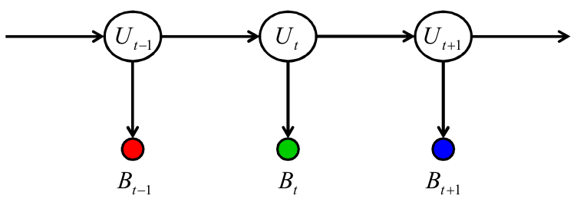
Hidden Markov Model
Urn traveling process (Markovian)
Ball reporting process (Multinomial, Gaussian)
Markov (invisible) is moving around the urns picking a ball.
Only to report the color of the ball.
We should guess where is he now?
Guess about next color.

Slide 14
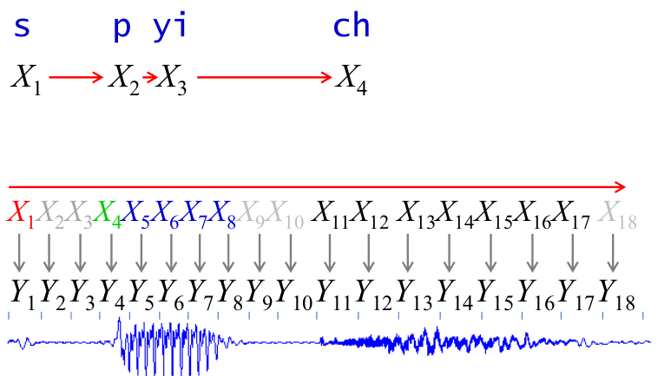
Hidden Markov Model
Illustration in Speech Recognition

Slide 15
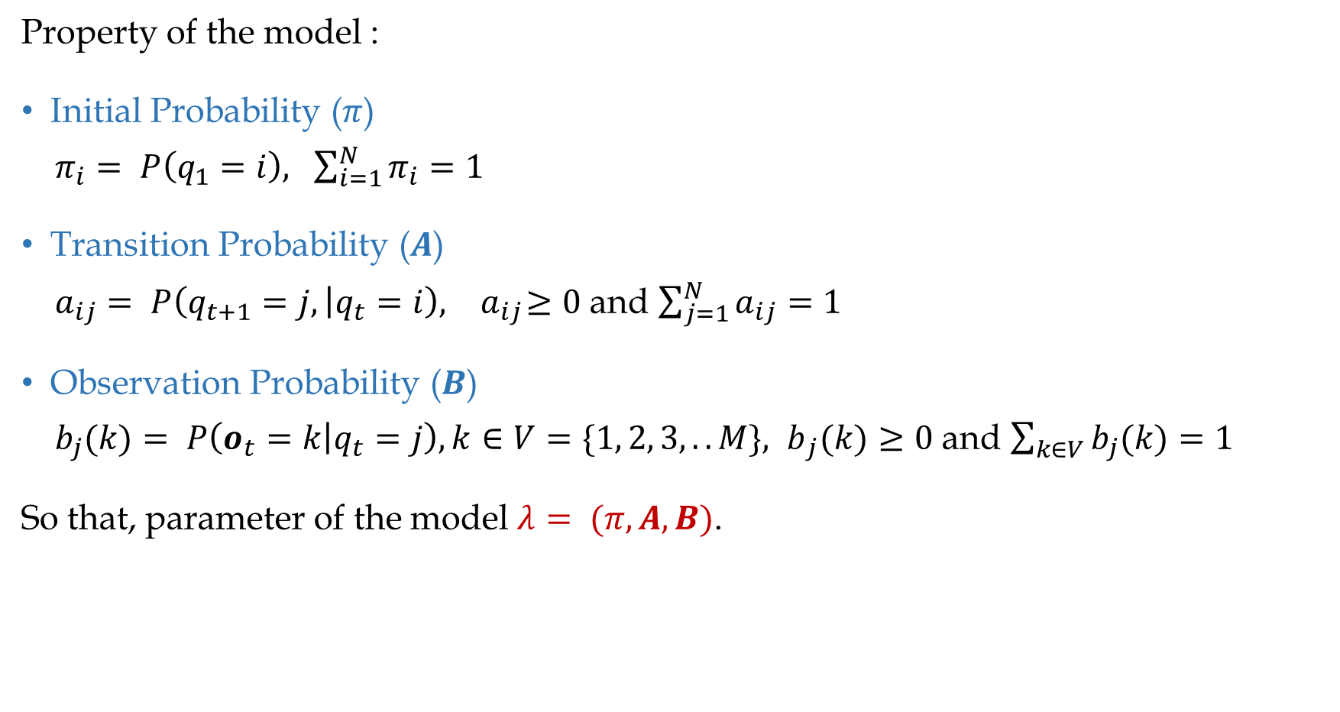
Hidden Markov Model
Property of the model :
Initial Probability ($π$)
$π_{i}= P\left(q_{1}=i\right),$ $\sum_{i=1}^{N}{π_{i}=1}$
Transition Probability ($A$)
$a_{ij}= P\left(q_{t+1}=j, | q_{t}=i\right),{ a}_{ij}≥0$ and $\sum_{j=1}^{N}{a_{ij}=1}$
Observation Probability ($B$)
$b_{j}(k)= P\left(o_{t}=k | q_{t}=j\right),{k∈V=\{1, 2, 3,..M\}, b}_{j}(k)≥0$ and $\sum_{k∈V}{b_{j}(k)=1}$
So that, parameter of the model $λ= (π, A,B)$.

Slide 16
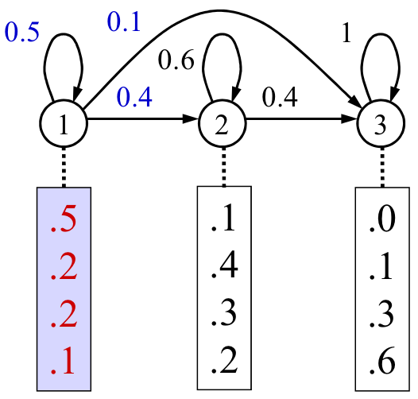

Hidden Markov Model
Model parameters
$$S=\left\{1, 2, 3\right\}, N=3$$
$$V=\left\{1, 2, 3,4\right\}, M=4$$
3 Matrices
$$π=\left[1 0.0 0.0\right]$$
$$A=\left[\begin{matrix}0.5 & 0.4 & 0.1 \\ 0.0 & 0.6 & 0.4 \\ 0.0 & 0.0 & 1.0\end{matrix}\right]$$
$$B=\left[\begin{matrix}0.5 & 0.2 & 0.2 \\ 0.1 & 0.4 & 0.3 \\ 0.0 & 0.1 & 0.3\end{matrix} \begin{matrix}0.1 \\ 0.2 \\ 0.6\end{matrix}\right]$$
1

Slide 17
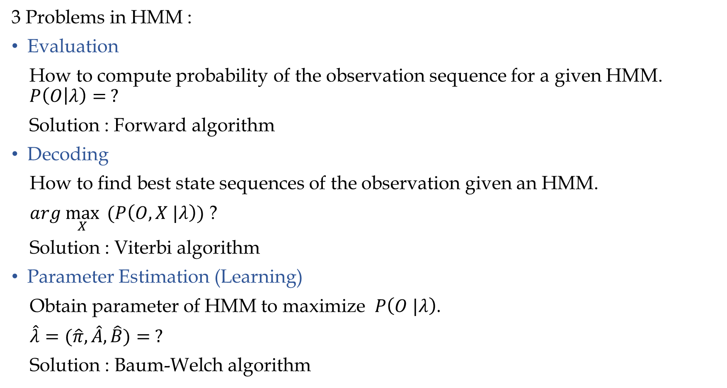
Hidden Markov Model
3 Problems in HMM :
Evaluation
How to compute probability of the observation sequence for a given HMM. $P\left(O | λ\right)= ?$
Solution : Forward algorithm
Decoding
How to find best state sequences of the observation given an HMM.
$arg \max_{X}{ (P\left(O,X |λ\right))}$ ?
Solution : Viterbi algorithm
Parameter Estimation (Learning)
Obtain parameter of HMM to maximize $P\left(O |λ\right)$.
$\hat{λ}=(\hat{π},\hat{A},\hat{B})= ?$
Solution : Baum-Welch algorithm

Slide 18
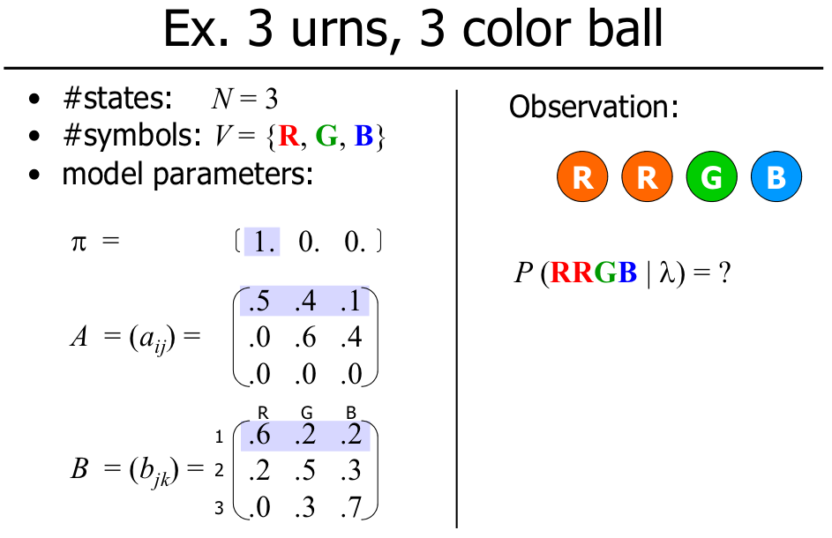
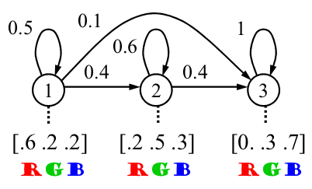
Hidden Markov Model
Evaluation
Hidden state
observable
Hidden

Slide 19
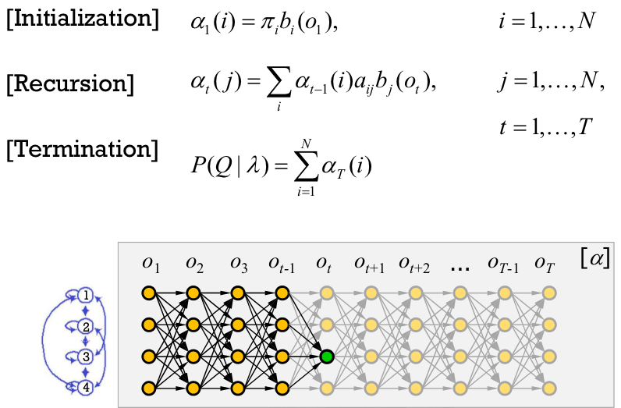
Hidden Markov Model
Evaluation :Forward Algorithm

Slide 20
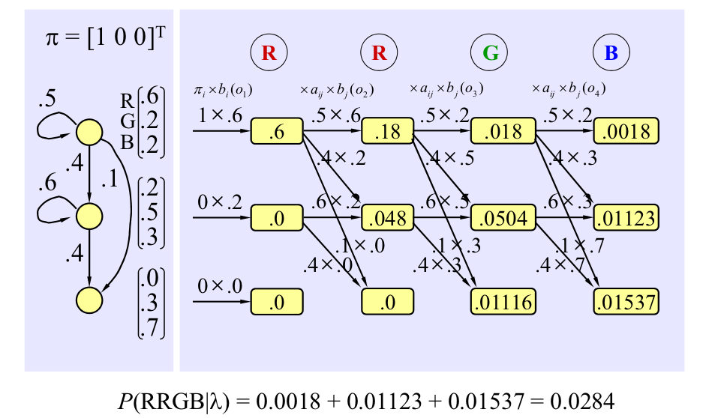
Hidden Markov Model
Transition
B = Observable Matrix
Observation Kasus
Atau sequence
Inisialisasi
Rekursi
Evaluation :Forward Algorithm
Probability
Observation
from
Observation
Sequence
Red di state
pertama
State
Hidden
State
Red di state kedua
Termination
Green DI state ke 3

Slide 21
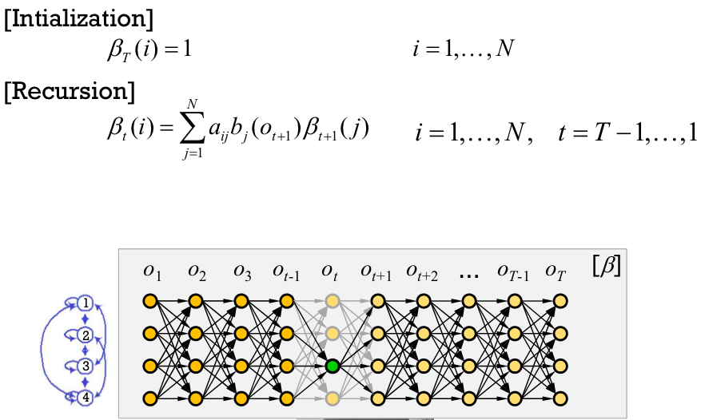
Hidden Markov Model
Evaluation : Backward Algorithm

Slide 22
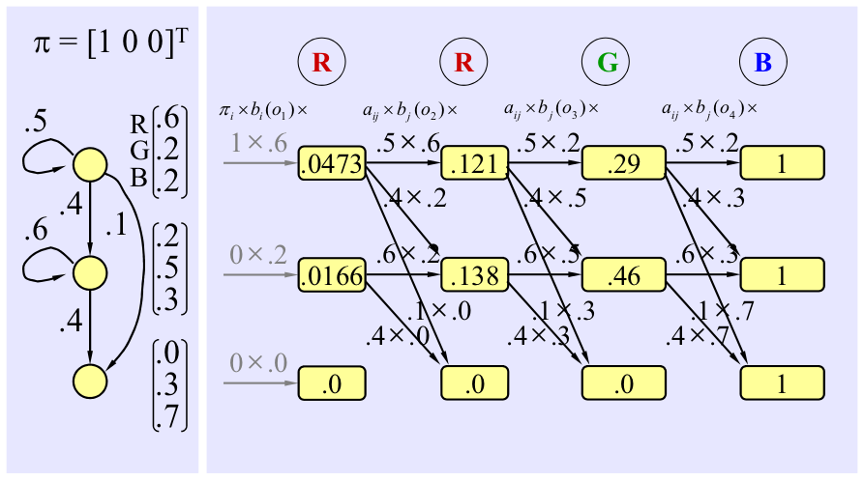

Hidden Markov Model
Evaluation : Backward Algorithm

Slide 23
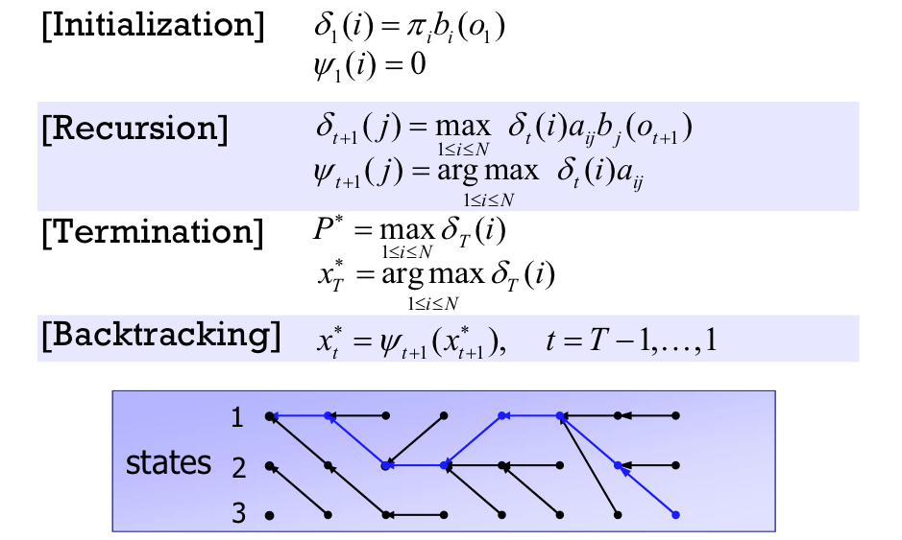
Hidden Markov Model
Decoding :Viterbi Algorithm

Slide 24
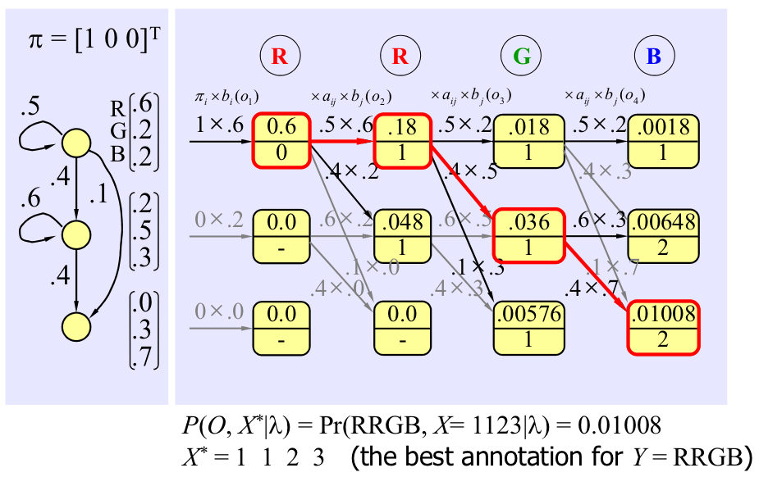
Hidden Markov Model
Decoding :Viterbi Algorithm
2
hidden
observable

Slide 25
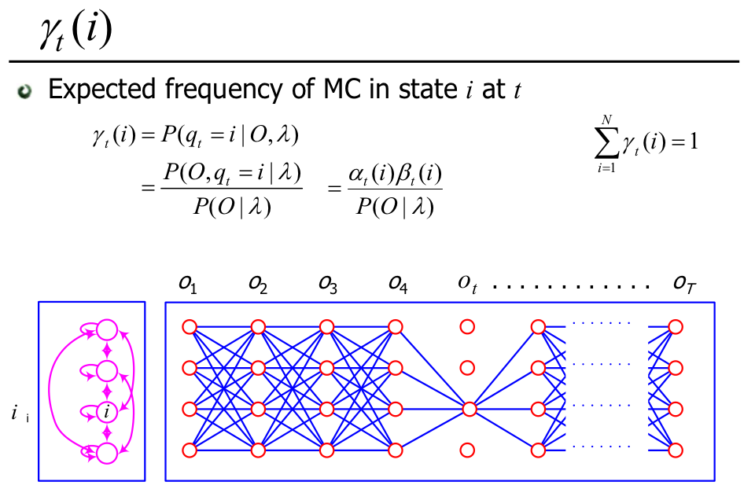
Hidden Markov Model
Parameter Estimation (Learning) : Baum-Welch Algorithm

Slide 26
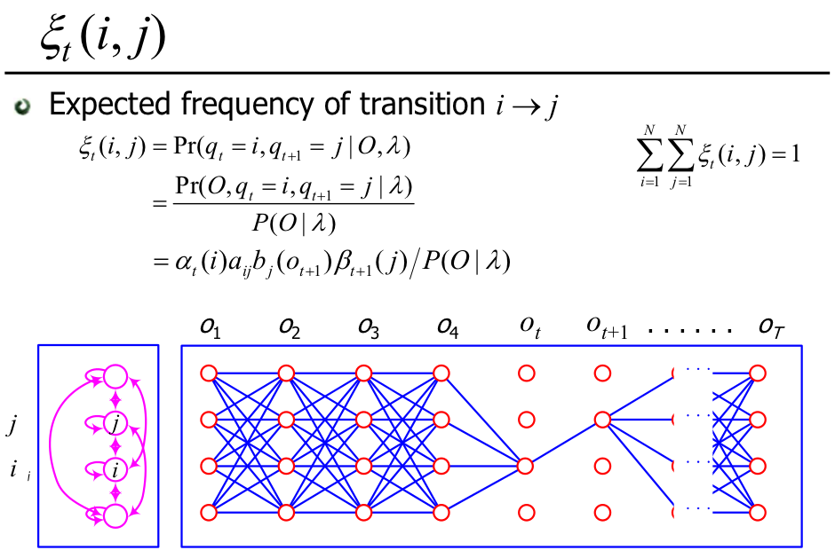
Hidden Markov Model
Parameter Estimation (Learning) : Baum-Welch Algorithm

Slide 27
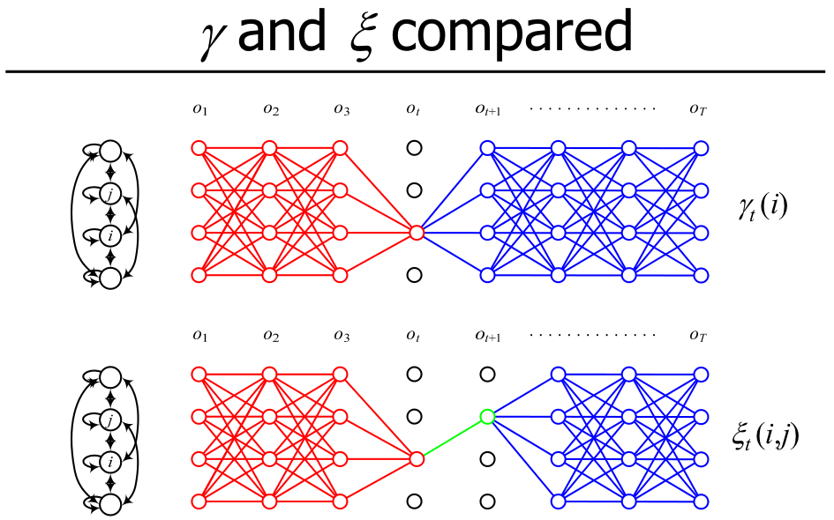
Hidden Markov Model
Parameter Estimation (Learning) : Baum-Welch Algorithm

Slide 28
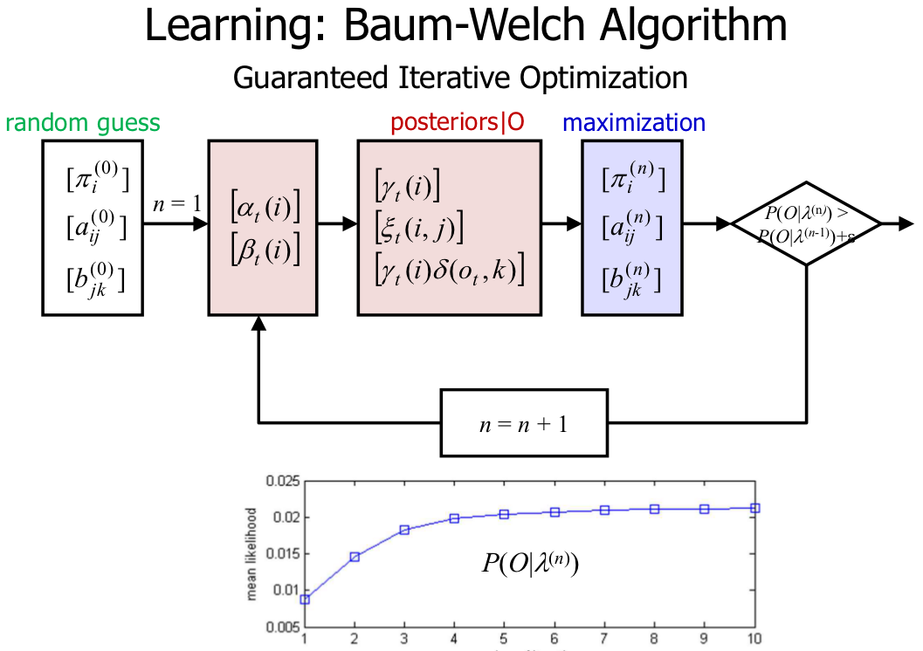
Hidden Markov Model
Parameter Estimation (Learning) : Baum-Welch Algorithm

Slide 29
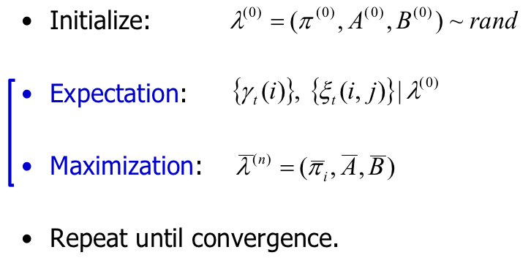
Hidden Markov Model
Parameter Estimation (Learning) : Baum-Welch Algorithm

Slide 30
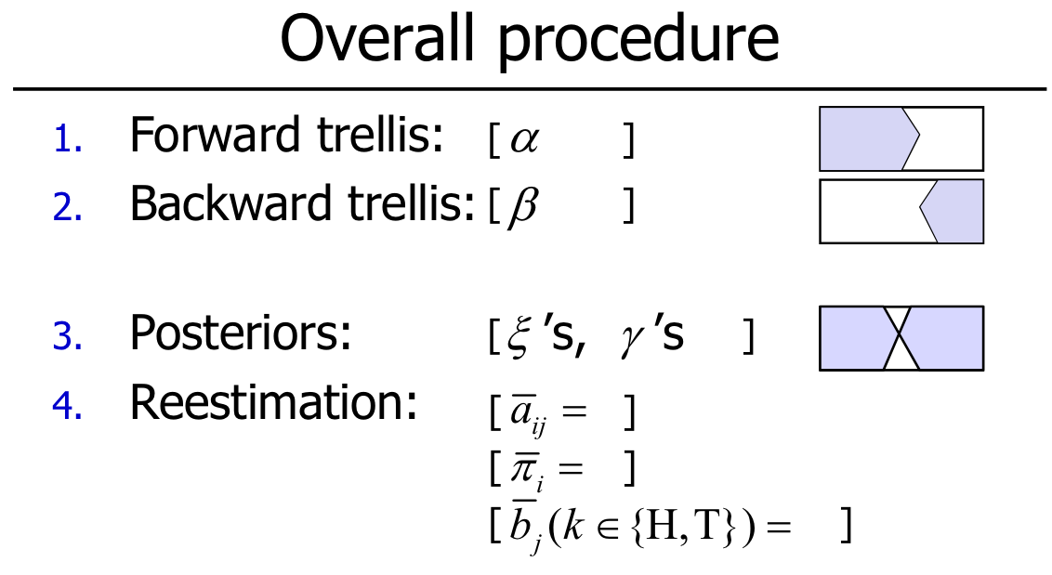
Hidden Markov Model
Parameter Estimation (Learning) : Baum-Welch Algorithm

Slide 31
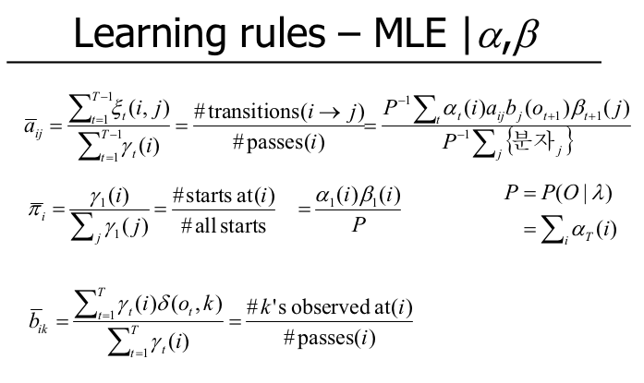
Hidden Markov Model
Parameter Estimation (Learning) : Baum-Welch Algorithm

Slide 32
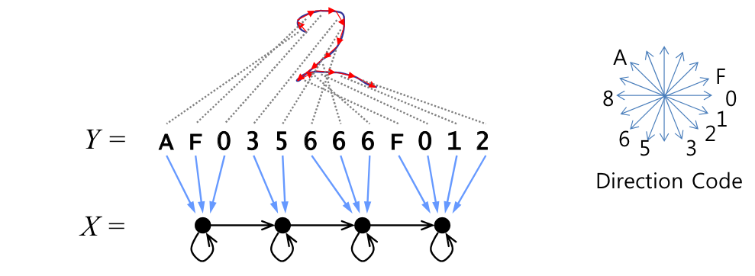
Hidden Markov Model
Case Study : Character recognition

Slide 33
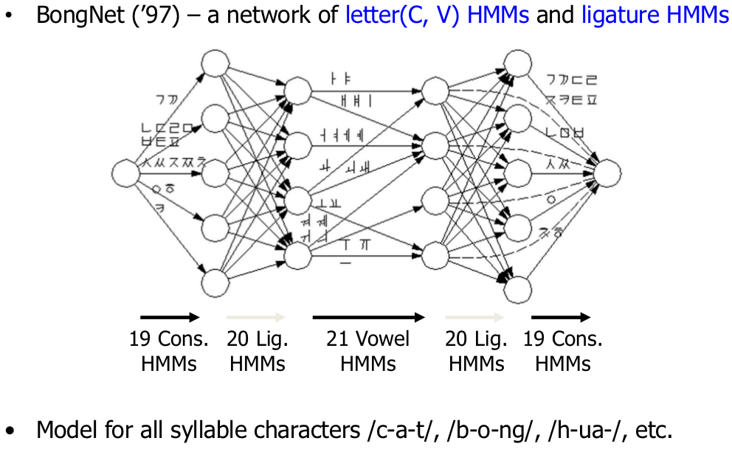
Hidden Markov Model
Case Study : Korean Hangul character recognition

Slide 34
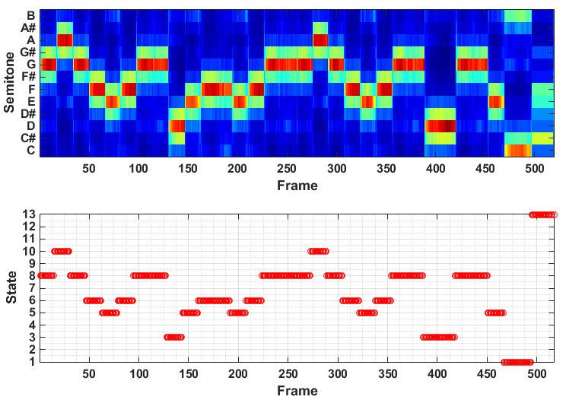
Hidden Markov Model
Case Study : Music Transcription
London Bridge Melody Decoding

Slide 35
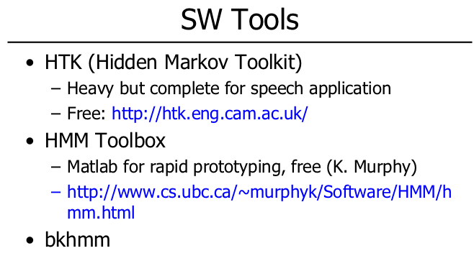
Hidden Markov Model

Slide 36
References
Bong-Kee Sin. Introduction to Hidden Markov Model. Lecturer Notes. 2014.
Bong-Kee Sin. Introduction to Hidden Markov Model. Lecturer Notes. 2015.
Mikael Nillson. First Order Hidden Markov Model : Theory and Implementation Issues. 2005.
Lawrance R. Rabiner. A Tutorial on Hidden Markov Model and Selected Applications in Speech Recognition. IEEE Proceedings, Vol. 77, No. 2, 1989.

Slide 37
Thank You

